Slide 1
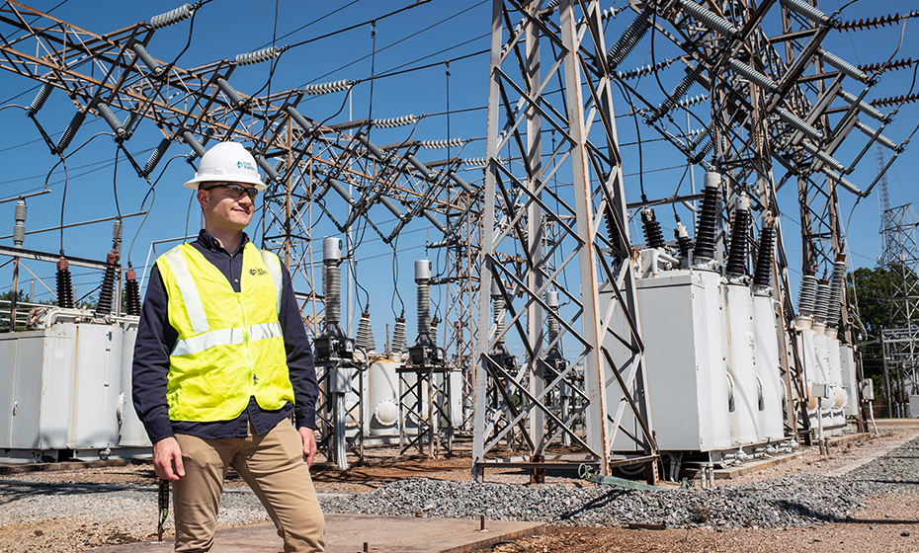
Battery Optimization Mid-Semester Check-In
By Group 1

Slide 2
Overview
Every five minutes, predicting a real time price schedule for the next 24 hours.
Predicting the real time price to optimize buying and selling energy.
Historical prices, forecasts, outages
Data source: Grid Statues - MISO

Slide 3
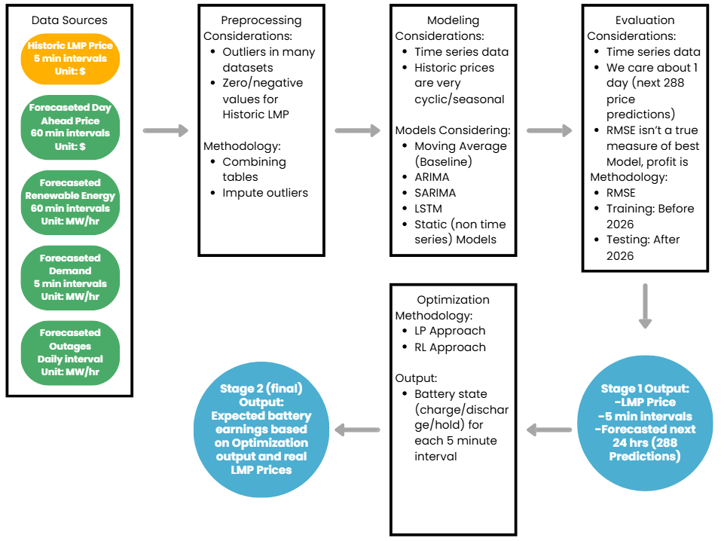

Slide 4
Workflow
Historical Data Collection
Prices, Forecast, outages
Data Preprocessing
Cleaning, interval alignment, data aggregation
Standard Models: Price Prediction Schedule
Machine Learning models forecast real-time prices
Model Evaluation
Find the best model to feed into the Buy/Sell optimization algorithms
Reinforcement Learning/Linear Programming:
Optimizing Buying and Selling
Exploring when to buy and sell energy
Notes:
Just an idea

Slide 5
Real Time Predictions

Slide 6
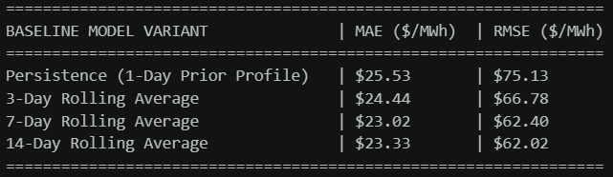
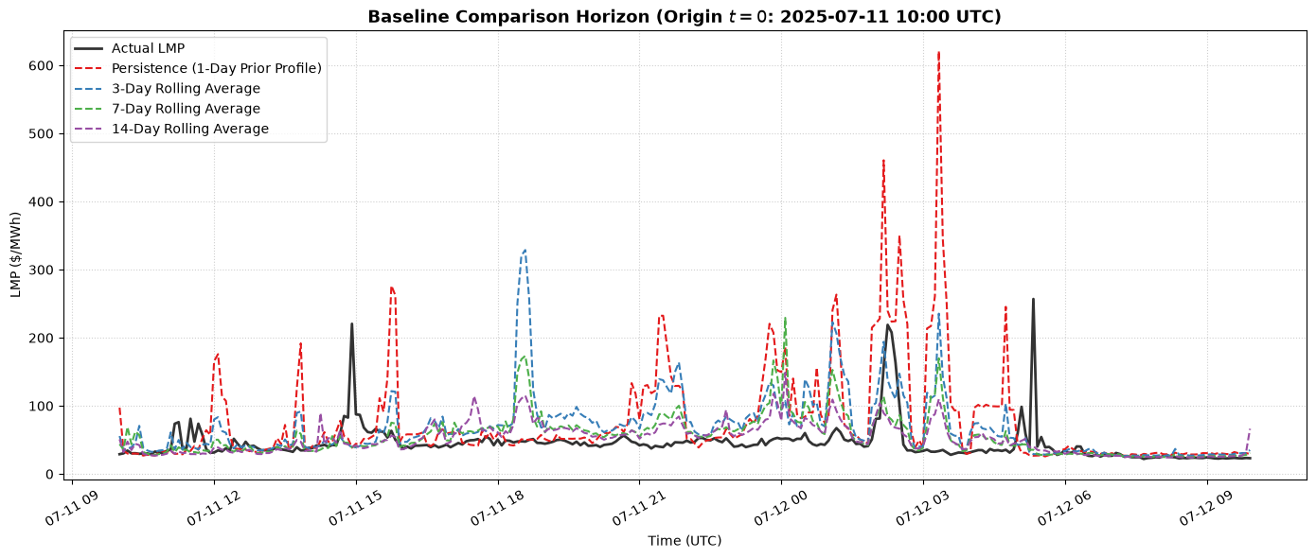
Baseline - Moving Average
Evaluated across various averaging windows
7 and 14 day Rolling Average performed the best
Target RMSE: $62.02
  No outliers removed

Slide 7
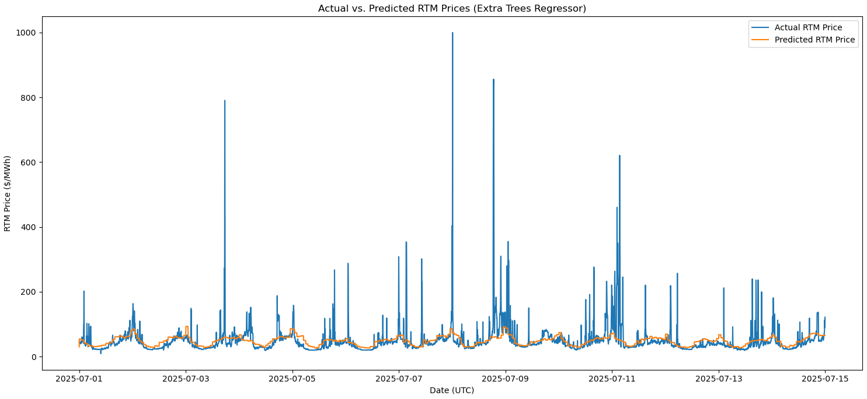
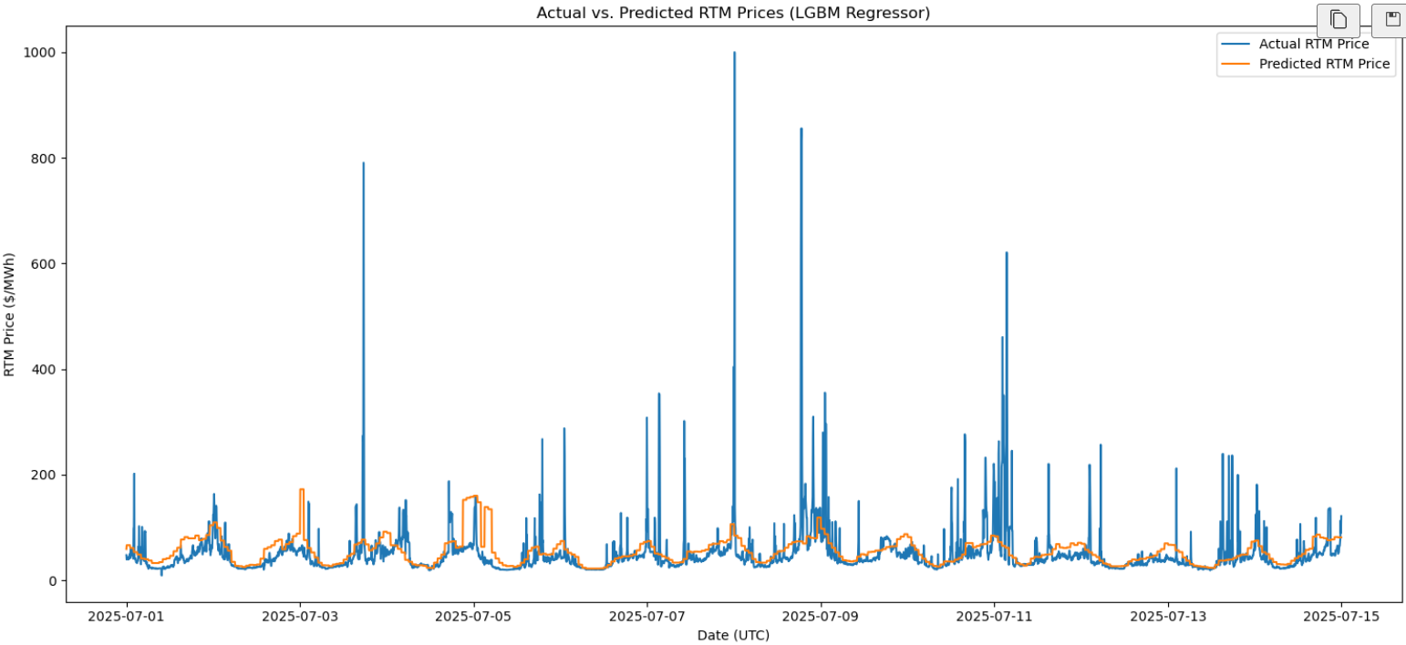
Model Testing
Models evaluated
  Random Forest Regressor
  XGBoost Regressor
  Hist Gradient Boosting Regressor
  Catboost Regressor
  LGBM Regressor
  Extra Trees Regressor

Slide 8
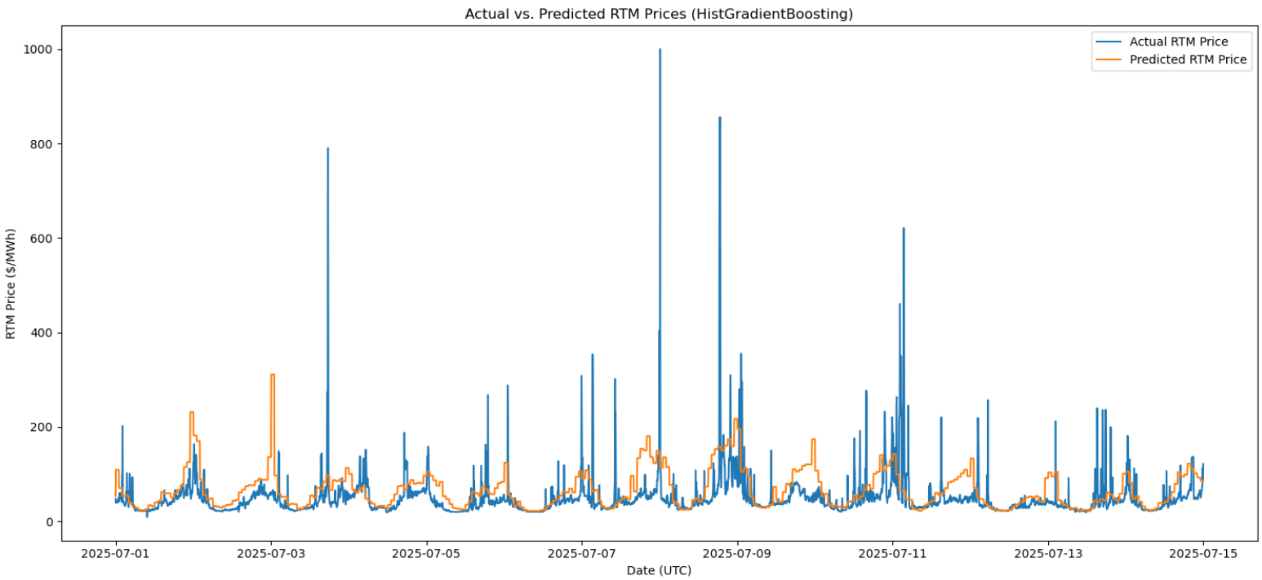
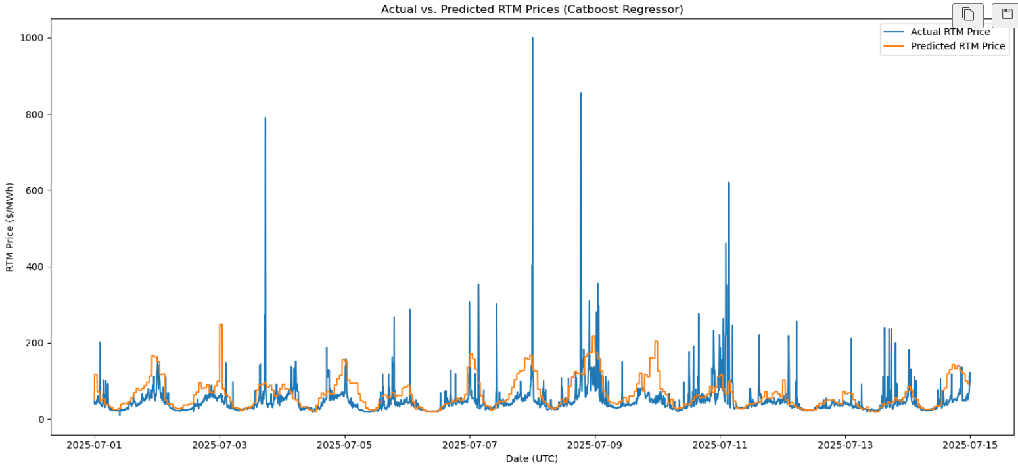
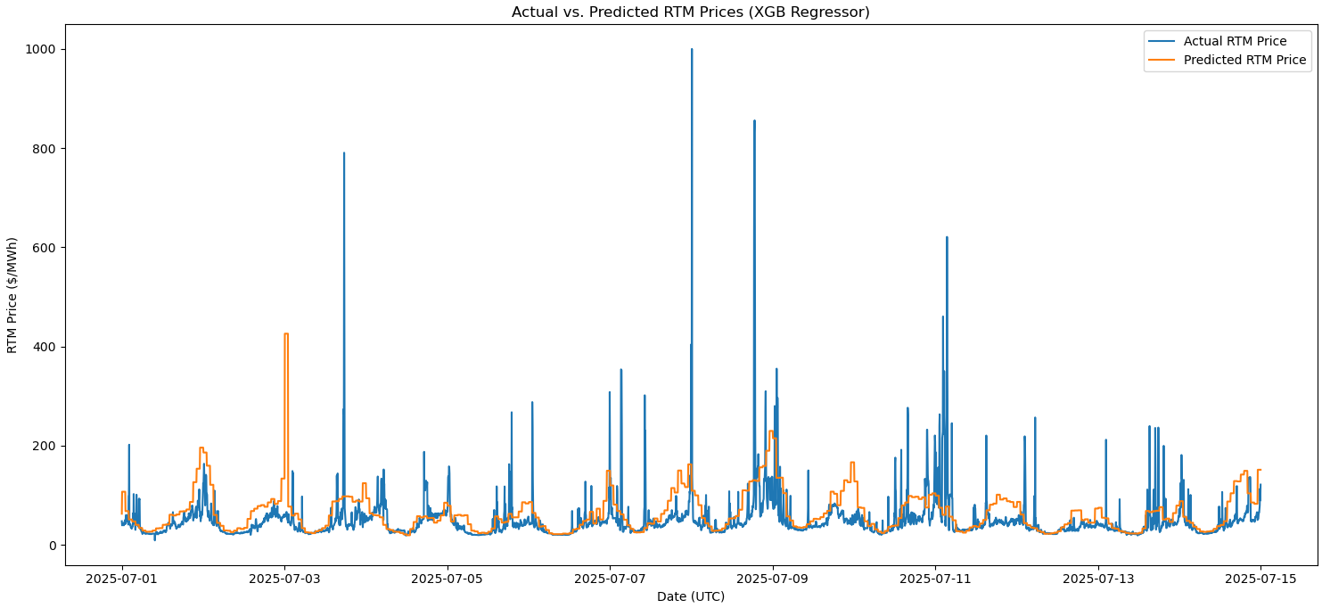
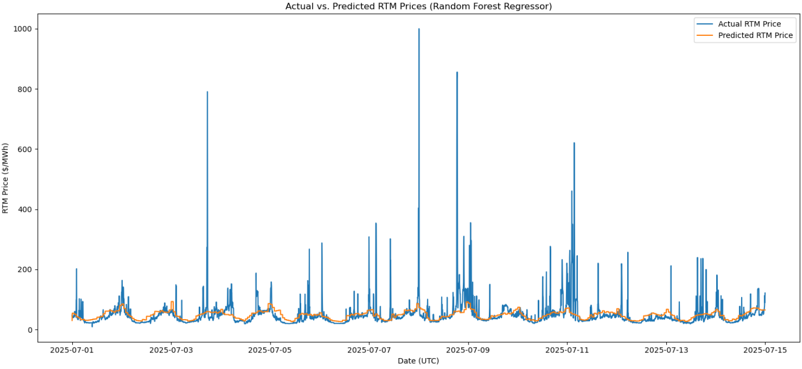

Slide 9
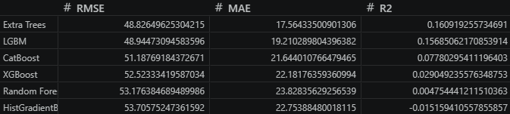
Evaluation
Extra Trees and LGBM performed the best
  Still working with hyperparameters but these two seem to be the frontrunners
Next steps:
  Implement forecast vectors
  Continue to tweak hyperparameters

Slide 10
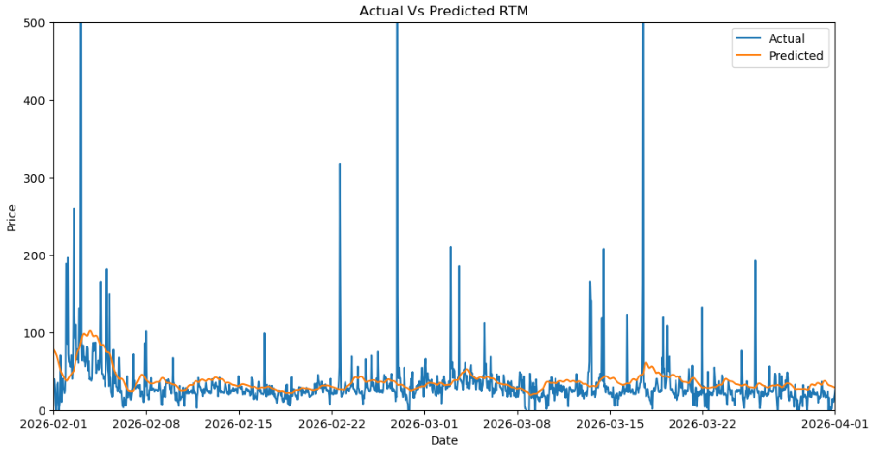
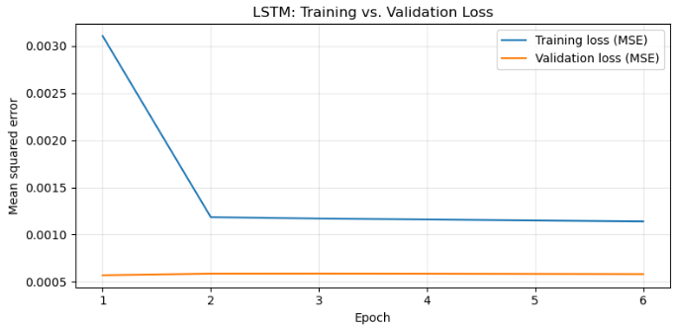
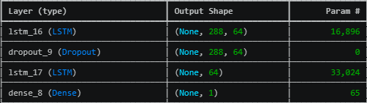
LSTM Model
Current Process:
Uses 288 time intervals for each prediction
Two Layer LSTM with 64 hidden units each
10% drop out for regularization
RMSE: $66.9
Next Steps:
Schedule Output
Expanding Window Size

Slide 11
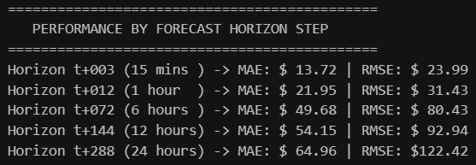
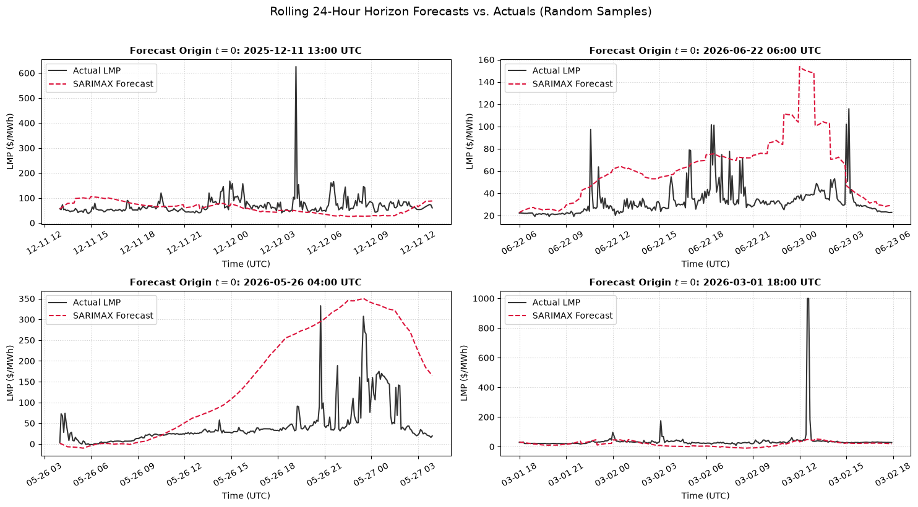
SARIMA X Model
Current Process:
Forecast Horizon - 288 Steps
Stride Steps - 300 Steps (25 hours) (limited by compute)
4 Fourier Terms
RMSE: $94.00
Next Steps:
Hyperparameter Tuning

Slide 12
Comparisons of Real Time Prediction Models
Model | RMSE
Baseline | $62.02
Extra Trees | $44.83*
LSTM | $66.90
SARIMA X | $94.00

Slide 13
Technical Progress
Reinforcement Learning
Simple RL Model → Single Schedule RL Model
Simple DQN Model → Single Schedule DQN Model
Debugging
  Parameter Tuning
    No matter how high I put gamma (future reward weight) or how low I put epsilon (choosing the best choice), it keeps giving reward of roughly [-price, 0, price]

Slide 14
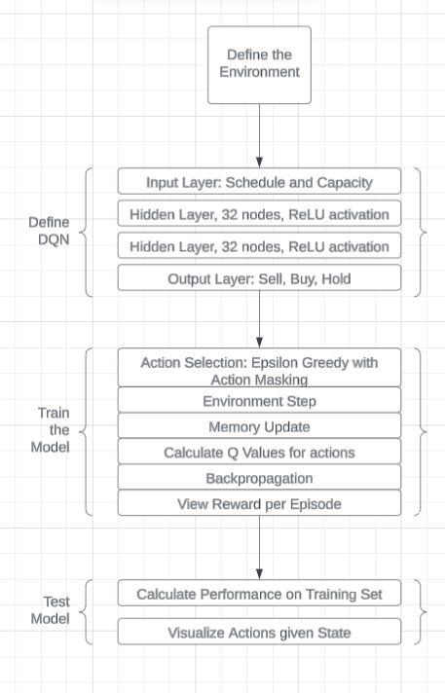
RL Workflow

Slide 15
Demo
Reinforcement Learning
Battery Single Schedule DQN

Slide 16
Challenges and Next Steps
RL:
Dual Schedule
Artificial Data Creation
Partial charges and discharges
Training with the cluster
  If this doesn’t solve the holding problem, more debugging and environment modification will be necessary
Optimization Algorithm
Linear Programming
Real Time Predictions:
Hyperparameter Tuning
Consistent Model Evaluation

